Slide 1
APIs are for Automata
PowerShell is for People
Stuart Macleod
github.com/stuartio
1 / 15

Slide 2


Slide 3
The Plan
Introductions
Modules in general
A little history
Tips from the Trenches, with demo!
Everyone goes home happy

Slide 4

Introductions
Who am I and what do I do?
Sr. Enterprise Architect @Akamai
Leads the Akamai PowerShell team
14-year PowerShell enthusiast
Scottish, not Irish or Australian (?!)
Who are Akamai and what do they do?
Largest CDN in the world
350,000 servers in nearly 2000 locations
~ 10% of all web traffic
CDN/Security/Compute/FAAS/etc. etc.

Slide 5
Why Make a Module?
Abstraction layer atop APIs
Ease of discovery
Help
Clear requirements
Better error handling
Smoothing over rough edges

Slide 6
Why does Akamai need a PowerShell module?
93 production APIs
Most customers will use 5-10
Requirements & styles differ
Complex authentication
Often CRUD operations use more than 1 API
Inside-Out Development

Slide 7
Akamai PowerShell
Started out as a side project
Written in native PowerShell
1.0 released 1st May 2020 ~ 350 functions
1.12 released 3rd May 2023 ~ 880 functions
2.0 released April 2024 (probably)
Now used by over 200 customers

Slide 8
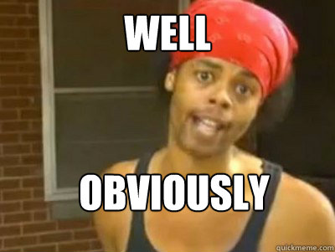
What did we learn?

Slide 9
Demo!
Notes:
Talk about talk from 2023 with Daniele Pecanha, Zhenhao Ye
Show EPS template

Slide 10


Tip #1
Don’t neglect PowerShell 5.1
Notes:
Differences in
Invoke-RestMethod
Arrays converting to single items
ConvertTo-JSON, or json use in general
File encoding in Out-File
Add a custom UA to track usage

Slide 11

Tip #2
Sign Your Scripts
Notes:
Many financial services companies enforce ExecutionPolicy via Group Policy
RemoteSigned will block scripts downloaded unless you change their Zone
AllSigned enforces across the board

Slide 12

Tip #3
Breakdown Large Modules
Notes:
Load time in 1.1 was 20-30s
Users typically only need a few functions
Modules should be smaller and all depend on Common
One function per file
Akamai module should depend on all its children to aid installation
Demo installation

Slide 13
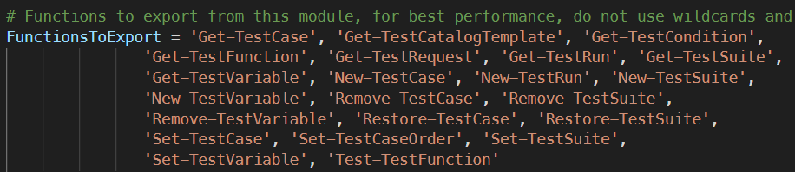
Tip #4
Use Explicit FunctionsToExport & AliasesToExport
Notes:
When using * the cache is not populated on first run, which happens a lot in containers

Slide 14

Tip #5
Use Approved Verbs
Notes:
Nothing wrong with activate-X, but the warning freaks out customers

Slide 15
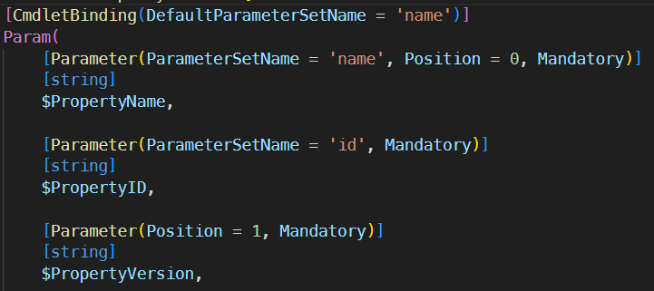
Tip #6
Focus on ease of use
Notes:
APIs are designed to talk to computers, not people
Name rather than ID
Version as latest
Parameterise simple POSTs and PUTs
ValidateSets/ArgumentCompletions
Retries/redirect chasing

Slide 16
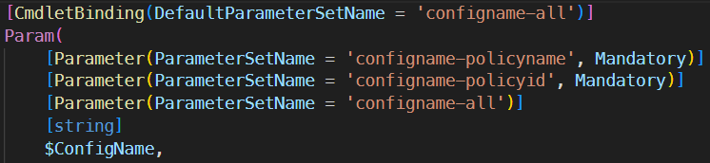
Tip #7
ParameterSets are great! (kinda)
Notes:
Beware multiple parameter sets with optional params
Always add cmdletbinding when using parameter sets, but watch out that it changes help output
Talk about how multiple parametersets looks in help
Many alternatives proposed, but no one has agreed on what would be better (and even if they do it wouldn’t support 5.1)

Slide 17
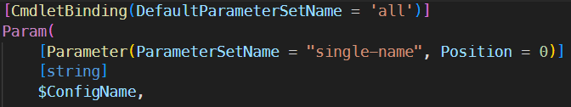
Tip #8
Support Positional Parameters where possible
Notes:
Any parameter sets implicitly disable positionality so it then has to be added back in. It also changes the help output format
Limit to only the most common parameters for simplicity

Slide 18

Tip #9
Embrace the pipeline!
Beware the pipeline…
Notes:
Talk about matching up Get and Set functions, including params
Caution editing request or response bodies too much
Allow users to specify request body without a data type
Watch out for functions with array bodies

Slide 19

Tip #10
The best way to help users is documentation
Notes:
Talk about PlatyPS and generating MD then XML
Include links to more detailed documentation

Slide 20

Tip #11
You need tests for everything, and you shouldn’t be doing them manually
Notes:
Tests coverage is now a prereq
Tests are rough, but work
Try to cover as many scenarios as possible, including parameter sets
Stubbing is extremely useful, mention OpenTest
Scripts which check things beyond functions, file naming, presence of default parameter sets, unused variables etc.

Slide 21
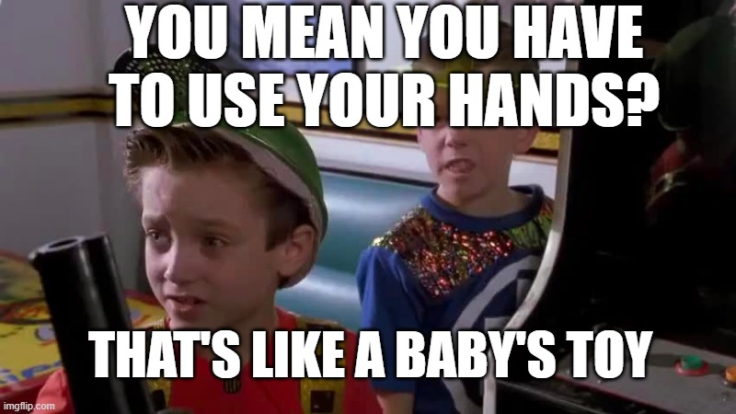
Tip #12
Auto-generate your code & tests
Notes:
Talk about talk from 2023 with Daniele Pecanha, Zhenhao Ye
Show EPS template

Slide 22
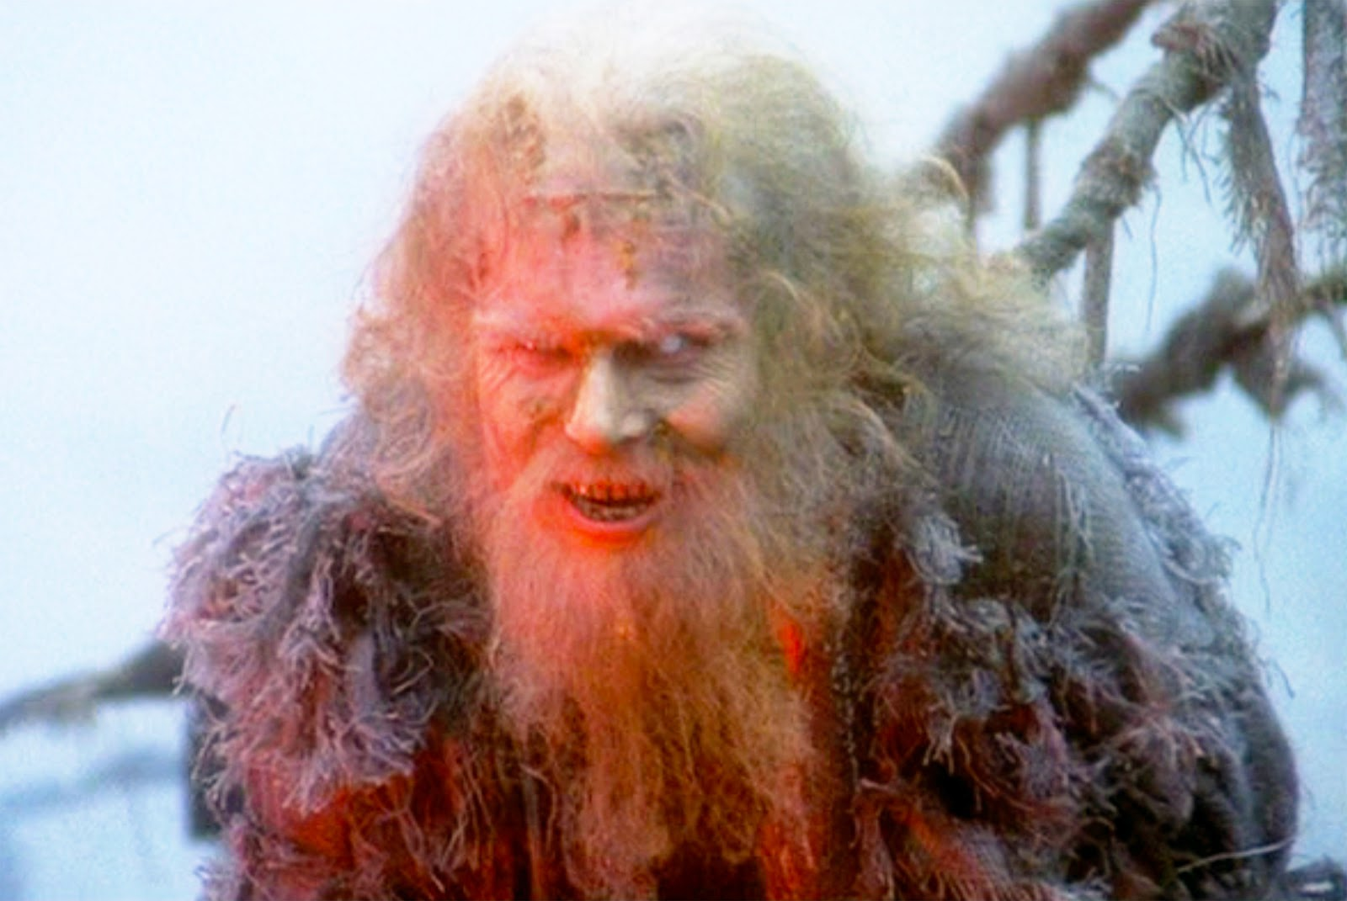
Any Questions?
Notes:
Talk about talk from 2023 with Daniele Pecanha, Zhenhao Ye
Show EPS template

Slide 23

THANK YOU
Please review this session

